Slide 1
Chapter 3.2
Accompanying PowerPoint

Slide 2
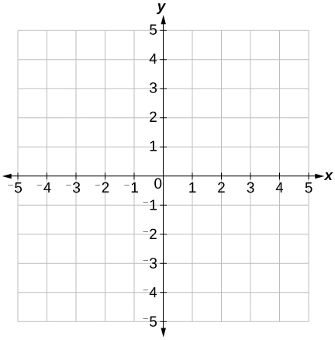


Graphs of Logarithmic Functions
Exponential y = b^{x}, b > 1
Logarithmic, y = log_{b}x
(1,0)
$$\left(−1,\frac{1}{b}\right)$$
(1,b)
(b,1)
$$\left(\frac{1}{b},−1\right)$$
(0,1)

Slide 3
For b > 0…
Exponential Function
Logarithmic Function
y = b^{x}
Domain: (–∞,∞)
Range: (0,∞)
y-intercept: (0,1)
Horizontal Asymptote: y = 0
y = log_{b}(x)
Domain: (0,∞)
Range: (–∞,∞)
x-intercept: (1,0)
Vertical Asymptote: x = 0

Slide 4
For 0 < b < 1
Exponential Function
Logarithmic Function
y = b^{x}
Domain: (–∞,∞)
Range: (0,∞)
y-intercept: (0,1)
Horizontal Asymptote: y = 0
y = log_{b}(x)
Domain: (0,∞)
Range: (–∞,∞)
x-intercept: (1,0)
Vertical Asymptote: x = 0

Slide 5


Ex) Graph and state the domain and range…
Vertical Shift Down 2
Horizontal Shift Right 2
f(x) = log₃x – 2
g(x) = log₃(x – 2)
$$\left(\frac{1}{3},−1\right)$$
(3,1)

Slide 6
Ex) Graph f(x) = –log₃(x + 3) + 4
Reflection Across x-axis
Horizontal and Vertical Shifts

